Slide 1

Lecture 03

Slide 2

There are many definitions:
Segmentation subdivides an image into its constituent regions or objects ( Gonzales, pp567)
Segmentation is a process of grouping together pixels that have similar attributes ( Efford , pp250)
Image Segmentation is the process of partitioning an image into non-intersecting regions such that each region is homogeneous and the union of no two adjacent regions is homogeneous ( Pal, pp1277)

Slide 3

Segmentation is typically associated with pattern recognition problems. It is considered the first phase of a pattern recognition process and is sometimes also referred to as object isolation.
Feature
Extraction
Image Segmentation
Classification
Input Image
Object Image
Feature Vector
Object Type

Slide 4

Segmentation algorithms have been used for a variety of applications. Some examples are :
  Optical character recognition(OCR)
  Automatic Target Acquisition
  Colorization of Motion Pictures
  Detection and measurement of bone, tissue, etc, in medical images.

Slide 5
Types of Segmentaion
Edge-based
  point, line, edge detection
Region-based

Slide 6
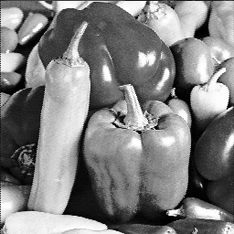

Region-based segmentation
Example 1
  Segmentation based on greyscale
  Very simple ‘model’ of greyscale leads to inaccuracies in object labelling

Slide 7
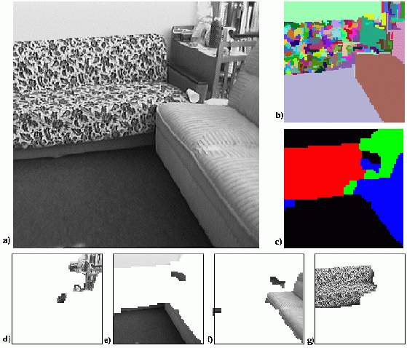
Region-based segmentation
Example 2
  Segmentation based on texture
  Enables object surfaces with varying patterns of grey to be segmented

Slide 8
Region-based segmentation
Example 3
  Segmentation based on motion
  The main difficulty of motion segmentation is that an intermediate step is required to (either implicitly or explicitly) estimate an optical flow field
  The segmentation must be based on this estimate and not, in general, the true flow

Slide 9

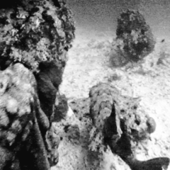



Slide 10
Region-based segmentation
Example 3
  Segmentation based on depth
  This example shows a range image, obtained with a laser range finder
  A segmentation based on the range (the object distance from the sensor) is useful in guiding mobile robots.
  Range segmentation is the task of segmenting (dividing) a range image, an image containing depth information for each pixel, into segments (regions), so that all the points of the same surface belong to the same region, there is no overlap between different regions and the union of these regions generates the entire

Slide 11
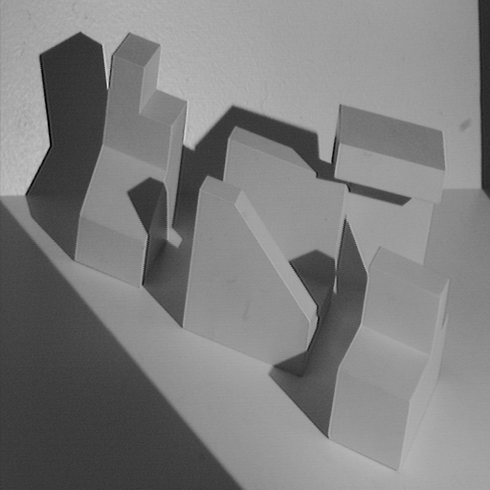
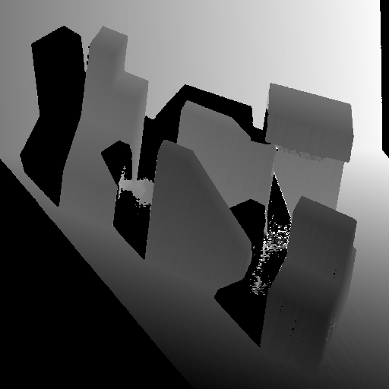
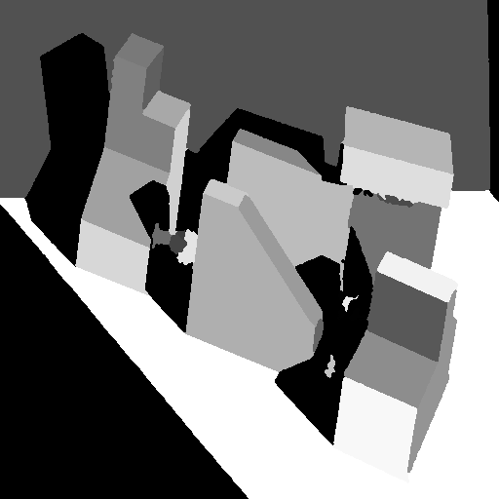
Range image
Original image
Segmented image

Slide 12
Grey level histogram-based segmentation
We will look at two very simple image segmentation techniques that are based on the greylevel histogram of an image
  Thresholding low and high
  Clustering
  Clustering methods consists in defining groups of pixels. Therefore, all the pixels in the same group define a class in the segmented image
We will use a very simple object-background test image
  We will consider a zero, low and high noise image

Slide 13



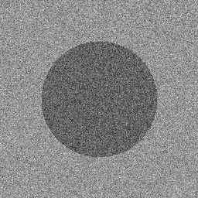
Noise free
Low noise
High noise

Slide 14
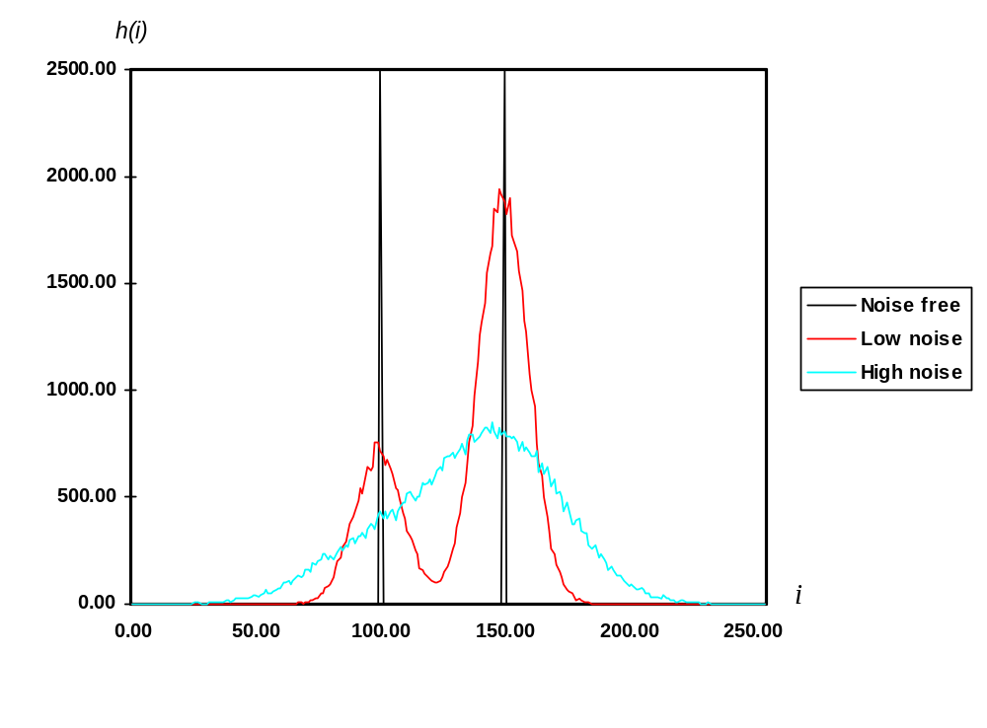

Slide 15
Greylevel thresholding
We can easily understand segmentation based on thresholding by looking at the histogram of the low noise object/background image
  There is a clear ‘valley’ between to two peaks

Slide 16

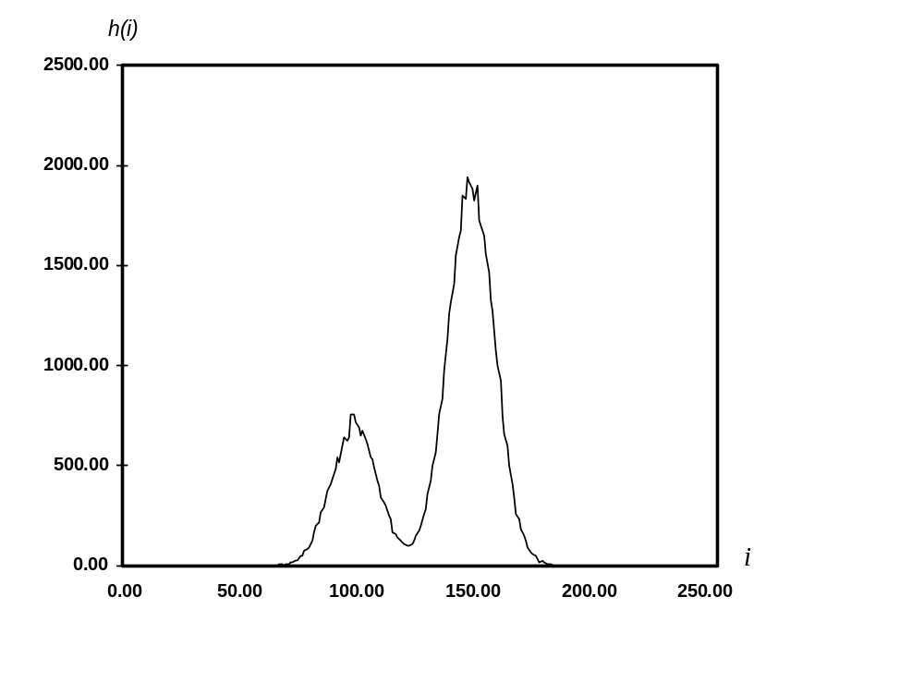
Background
Object
T

Slide 17
Greylevel thresholding
We can define the greylevel thresholding algorithm as follows:
  If the greylevel of pixel p <=T then pixel p is an object pixel
else
  Pixel p is a background pixel

Slide 18

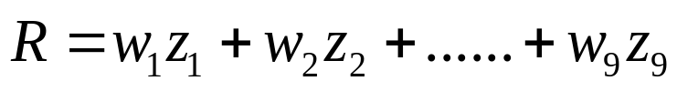
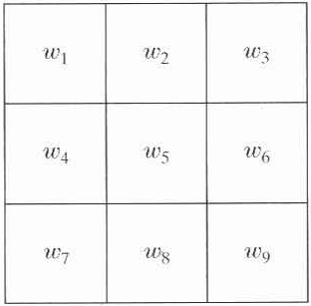
Edge-based segmentation
There are three basic types of gray-level discontinuities in a digital image: points, lines, and edges
The most common way to look for discontinuities is to run a mask through the image.
We say that a point, line, and edge has been detected at the location on which the mask is centered if ,where

Slide 19
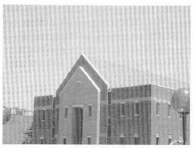
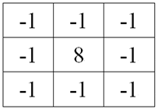
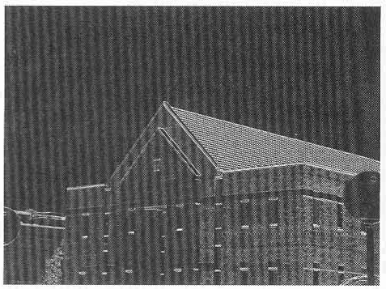
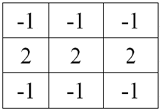
Edge-based segmentation
Point detection
a point detection mask
Line detection
a line detection mask

Slide 20
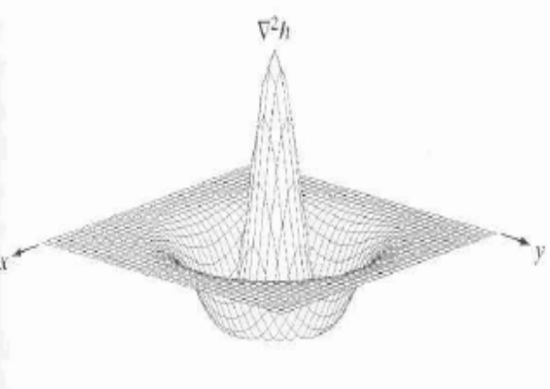
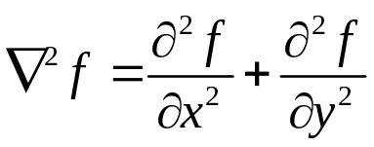
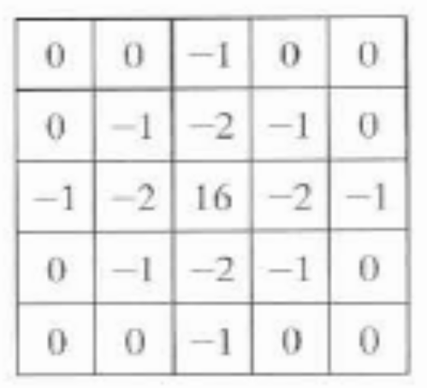
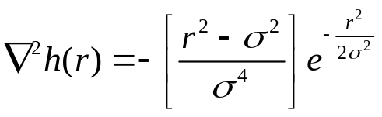
Edge-based segmentation
Edge detection: Laplacian operation

Slide 21
In image processing and especially edge detection, when we apply sobel convolution matrix to a given image,
we say that we got the first derivative of the input image,and when applying the laplacian matrix to the initial image we say that we got the second derivative.

Slide 22
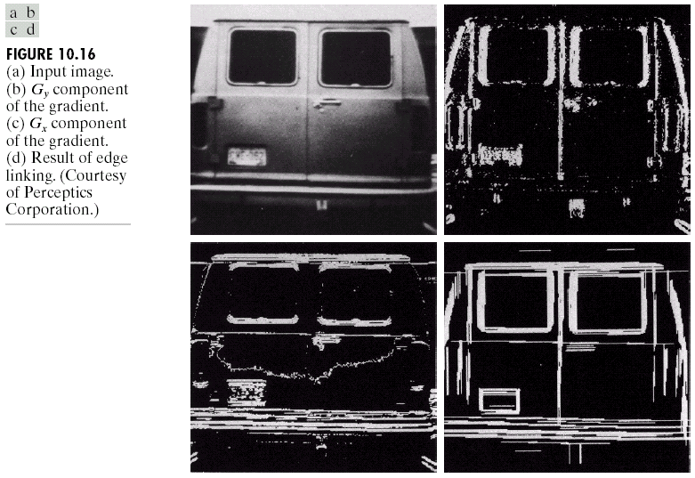
Edge Linking and Boundary Detection
Local Processing: Example
In this example,
we can find the
license plate
candidate after
edge linking
process.

Slide 23
Edge linking and Boundary Detection
Ideally discontinuity detection techniques identify pixels on the boundary between regions
In practice there may be breaks in boundary and spurious intensity discontinuities due to
  Non uniform illumination
  Presence of noise
Edge linking procedures assemble edge points into meaningful boundaries
  Local Processing
  Global Processing

Slide 24
Local Processing
Analyze each pixel in a small neighborhood of every point (x, y)
  All points that are similar in nature are linked
  This forms a boundary of pixels that are similar in nature
Similarity can be
  strength of the gradient response or
  direction of the gradient
  gradient the change in the direction of the intensity level of an image

Slide 25
They are typically used to describe the local structure of an image and are useful for tasks such as object detection , recognition , and matching . On the other hand , global features in image processing refer to overall characteristics of an entire image , such as color , shape , and texture distribution.
The Hough transform is a popular feature extraction technique that converts an image from Cartesian to polar coordinates.
Polar coordinates represent the same point in space as cartesian, but as a distance and angle from the origin.

Slide 26
Global Processing
Hough Transform
y
y=m₁x+c₁
c
(c₁, m₁)
c₁
m₁ is slope
c₁ is the y-intercept
x
m₁
m
y
C = -mx₁+y₁
c = -mx₁+y₁
c
y₁
(x₁, y₁)
x₁
x
m

Slide 27
Global Processing
Hough Transform
y
y=m’x+c’
c
(x₂, y₂)
c'
(c’, m’)
(x₁, y₁)
x
m'
m
c_{max}
0 0 0 0 0 0
0 0 0 0 0 0
0 0 0 0 0 0
0 0 0 0 0 0
0 0 0 0 0 0
c_{min}
m_{min}
m_{max}

Slide 28
Global Processing
Take points (x_{k}, y_{k}) on a boundary line
for m = m_{min} to m_{max}
{
c = round(-mx_{k}+y_{k})
A(c, m) ++;
}
c_{max}
0 0 0 0 0 0
0 0 0 0 0 0
0 0 0 0 0 0
0 0 0 0 0 0
0 0 0 0 0 0
c_{min}
m_{min}
m_{max}

Slide 29
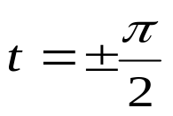


Global Processing
Normal representation of line
y
r = xcos(t) + y sin(t)
r
t
x
r_{max}
0 0 0 0 0 0
0 0 0 0 0 0
0 0 0 0 0 0
0 0 0 0 0 0
0 0 0 0 0 0
r_{min}
t_{min}
t_{max}

Slide 30
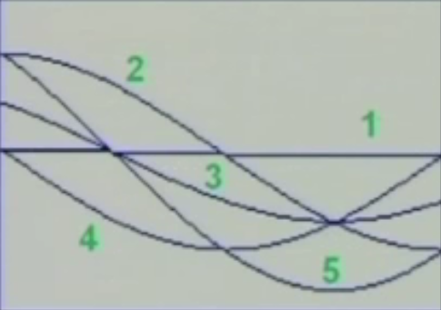
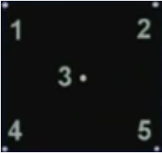
A simple example

Slide 31
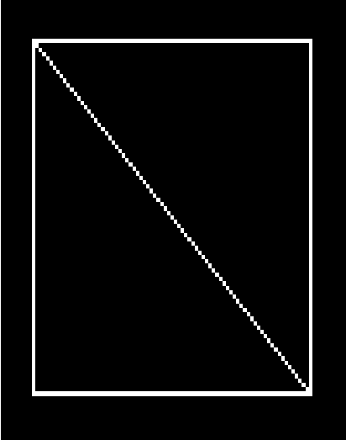
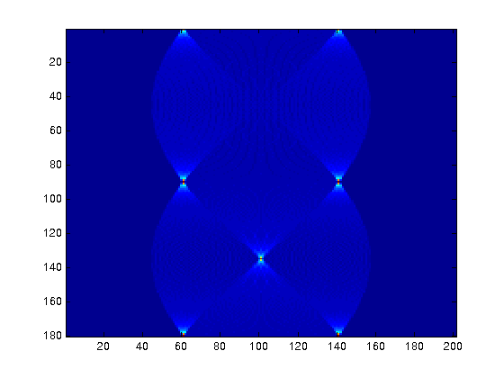
A simple example
φ
w

